Slide 1
Data Mining & Analytics - 6183
Group Coursework - Disaster Management
Group Number 26
Group Member:
Umesh Uddar - 34884157
Kishore Rajendra - 34812636
Vyom Khanna - 28965736
Sachin Suresh - 34812598

Slide 2
Country
Country Code - B
Cambodia, Ethiopia, Ghana, Indonesia, Jordan, Mali, Morocco, Mozambique, Myanmar, Nepal, Niger, Pakistan, I.R. Iran.
Countries assigned to each member:
Umesh Uddar : Cambodia, Ethiopia, Ghana, Indonesia
Kishore Rajendra : Jordan, Mali, Morocco
Sachin Suresh : Mozambique, Myanmar, Nepal
Vyom Khanna : Niger, Pakistan, I.R. Iran

Slide 3

Data Extraction
Jordan
Iran
Morocco
Mali
Combodia
Nigar
Indonesia
Ghana
Pakistan
Mozambique
Ethiopia
Nepal
Myanmar
Disaster Data from https://www.desinventar.net/ records various disasters across Cambodia, Ethiopia, Ghana, Indonesia, Jordan, Mali, Morocco, Mozambique, Myanmar, Nepal, Niger, Pakistan, and Iran.

Slide 4
Data Pre-processing
Using R script the columns having all null values are removed.
Applying count if formula across the column and the columns having 90% null data are removed.
Manually the columns having similar combination are combined into single columns and the event combination are categorized based on the incident.

Slide 5
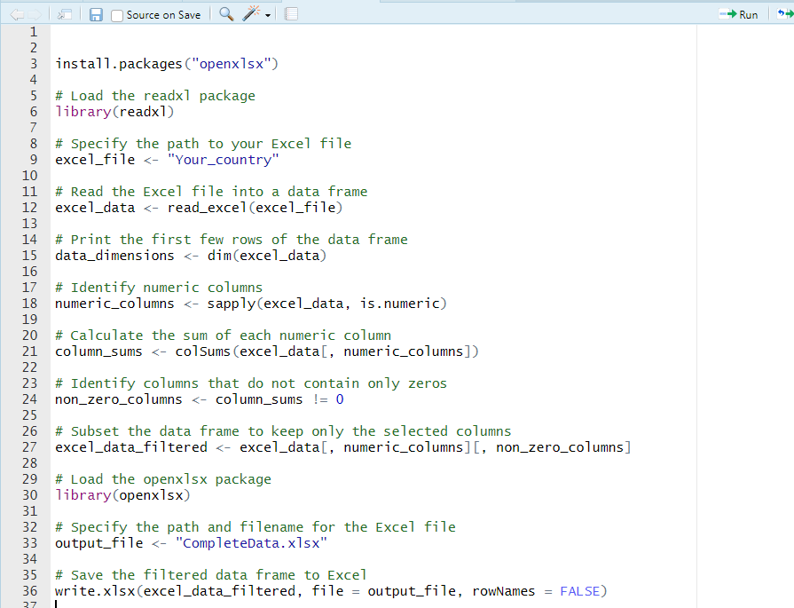
R Script to Remove Null Columns

Slide 6
Handling missing values
Utilizing the Random Forest imputation methodology, we trained a sophisticated model to predict and fill in missing values within our dataset. This approach enhances data completeness by leveraging the relationships and patterns observed in the existing data.
By strategically employing Random Forest for imputation, we ensure a more robust and accurate completion of missing values, contributing to the overall integrity and reliability of our dataset.

Slide 7
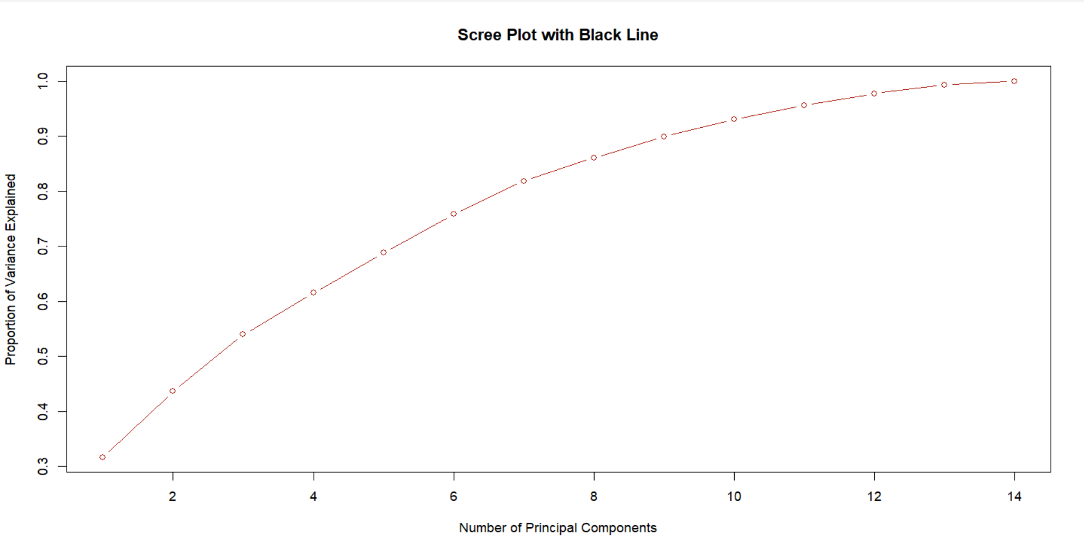
PCA Principal Component Analysis

Slide 8
Data Visualization
Bar Graph
Missing , Injured, Death v/s Events
2. Pie chart
Event_comb v/s infrastructure
3. Box plot

Slide 9
Bar plot
In this jbdfkjvnldkjnvfkndk

Slide 10
Pie Chart
dfhbvkjdshbvkjhbskjdvbkjsd

Slide 11
Pie Chart
dfhbvkjdshbvkjhbskjdvbkjsd

Slide 12
Regression model - Losses
The Adjusted R-squared (Adjusted R²) is a statistical measure that evaluates the goodness of fit of a regression model. It takes into account the number of predictors in the model, providing a more realistic assessment of the model's explanatory power. The Adjusted R² adjusts the R-squared value by penalizing the addition of irrelevant predictors that do not significantly contribute to the model's explanatory ability.
Multilinear Regression (Adjusted R² = 0.735):
The adjusted R-squared value of 0.735 indicates that approximately 73.5% of the variability in the dependent variable (Losses) is explained by the independent variables included in the multilinear regression model.
This model accounts for the relationship between the predictors and the target variable but may have room for improvement or may include some less relevant variables.
XG Boost (Adjusted R² = 0.8924):
The higher adjusted R-squared value of 0.8924 suggests that the XG Boost model performs better in explaining the variability in Losses compared to the multilinear regression model.
XG Boost is a powerful machine learning algorithm that can capture complex relationships in the data, and the higher adjusted R-squared indicates that it has captured more of the variability in Losses.
In summary, the XG Boost model with an adjusted R-squared of 0.8924 is providing a better fit to the data and explaining a higher proportion of the variability in Losses compared to the multilinear regression model with an adjusted R-squared of 0.735. This suggests that XG Boost is a more effective model for predicting or understanding the Losses variable in your dataset.

Slide 13
Regression model - Deaths
The Adjusted R-squared (Adjusted R²) is a statistical measure that assesses the goodness of fit of a regression model, taking into account the number of predictors in the model. The Adjusted R² provides a more realistic indication of the model's explanatory power by penalizing the inclusion of irrelevant predictors.
Multiple Linear Regression (Adjusted R² = 0.5037):
The adjusted R-squared value of 0.5037 suggests that approximately 50.37% of the variability in the dependent variable (Deaths) is explained by the independent variables included in the multiple linear regression model.
This model captures some of the relationship between the predictors and Deaths but may have limitations in explaining a significant portion of the variability.
XG Boost (Adjusted R² = 0.720):
The higher adjusted R-squared value of 0.720 indicates that the XG Boost model performs better in explaining the variability in Deaths compared to the multiple linear regression model.
XG Boost, being a more complex and flexible machine learning algorithm, is capable of capturing intricate patterns and nonlinear relationships in the data, leading to a better fit.
In summary, the XG Boost model with an adjusted R-squared of 0.720 is providing a superior fit to the data and explaining a higher proportion of the variability in Deaths compared to the multiple linear regression model with an adjusted R-squared of 0.5037. This suggests that XG Boost is a more effective model for predicting or understanding the Deaths variable in your dataset.

Slide 14
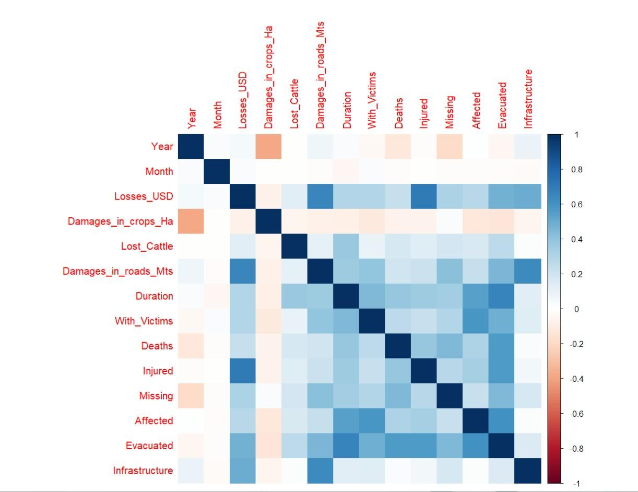
Finding correlation
A correlation heatmap is a graphical representation of the correlation matrix, where each cell in the matrix is color-coded to represent the correlation between two variables.
Correlation coefficients range from -1 to 1.
A value of 1 indicates a perfect positive correlation (as one variable increases, the other variable increases proportionally).
A value of -1 indicates a perfect negative correlation (as one variable increases, the other variable decreases proportionally).
A value of 0 indicates no linear correlation.

Slide 15
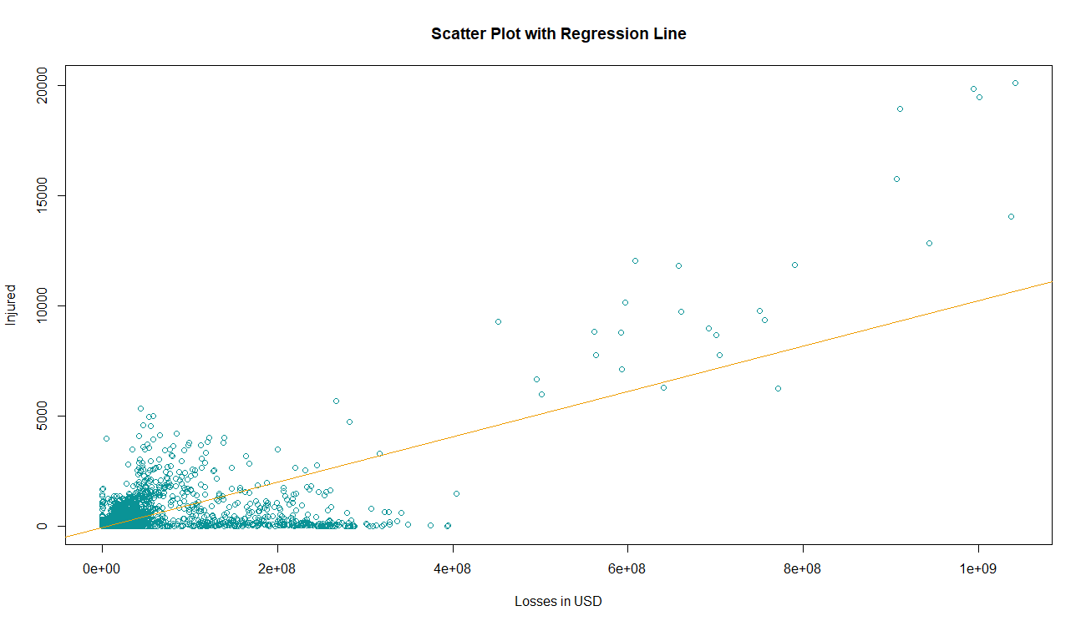
linear regression model injured v/s losses_usd
An adjusted R-squared of 0.50 suggests that half of the variability in the Injured variable is explained by the linear regression model with Losses_USD as the predictor.

Slide 16
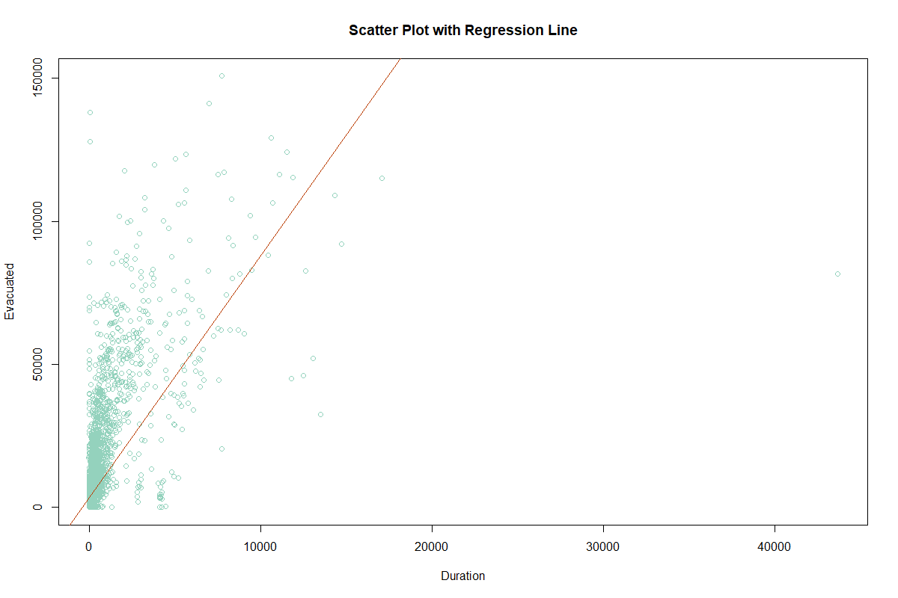
Build linear regression model EVACUATED v/s Duration
An adjusted R-squared of 0.453 suggests that half of the variability in the Injured variable is explained by the linear regression model with Losses_USD as the predictor.

Slide 17
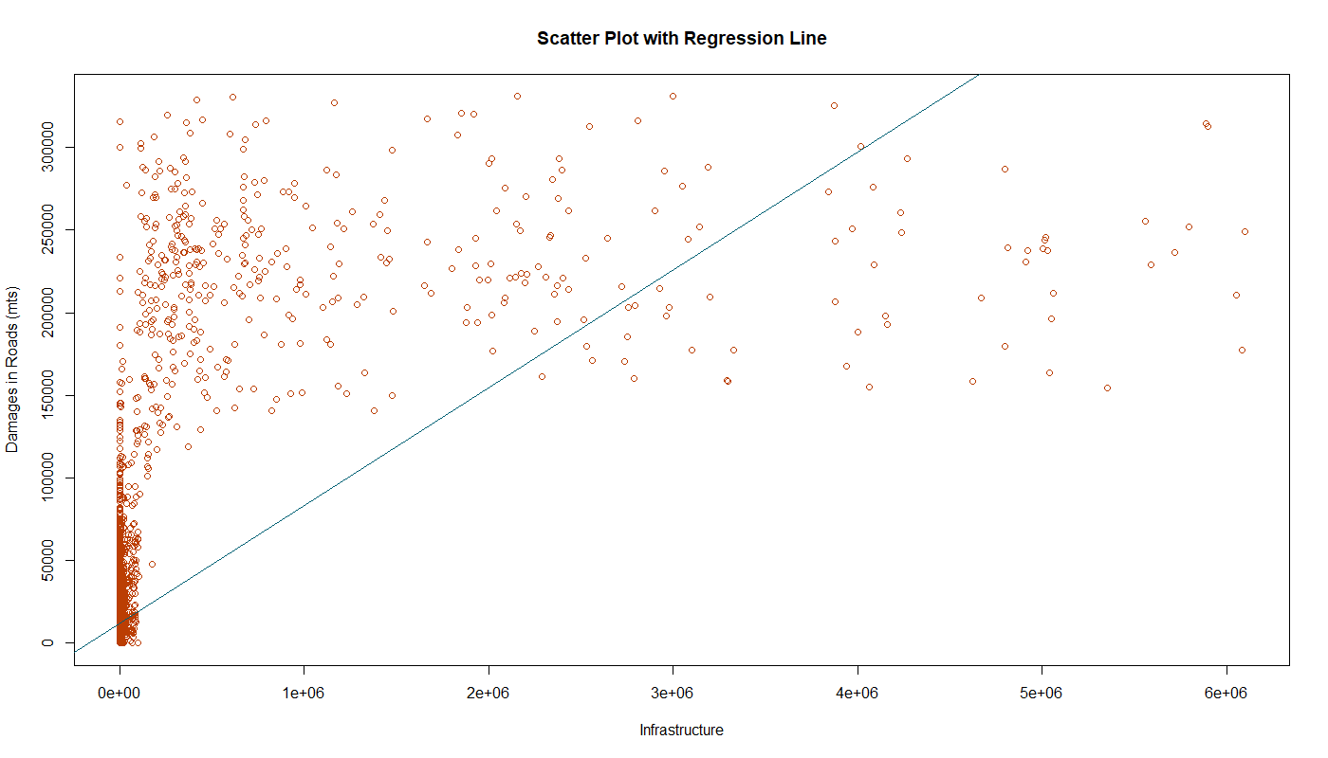
Build linear regression model INFRASTRUCTURE v/s DAMAGE IN ROAD
Adjusted r^2 = 0.3992

Slide 18
Classification Models
1. Random Forest: Random Forest, an ensemble learning algorithm, excels in classification and regression tasks, offering robustness, high accuracy, and adeptness in handling large and complex datasets. Known for its minimal hyperparameter tuning, it belongs to decision tree-based methods, providing reliable predictions.
2. K-Means : K-Means is a widely used clustering algorithm for unsupervised partitioning of datasets into K distinct clusters. It iteratively minimizes within-cluster variance, ensuring data points are grouped to minimize the sum of squared distances to their assigned cluster centroids.
3. XG-Boost : XG-Boost is a versatile and robust machine learning algorithm, excelling in classification and regression tasks. By constructing a sequence of decision trees and iteratively correcting errors, XGBoost minimizes the gradient of the loss function, showcasing its effectiveness in improving predictive accuracy.

Slide 19
Data Classification
1. Country
The Random Forest model achieved an accuracy of 73.76%, indicating its ability to correctly predict the country of a disaster nearly three-fourths of the time. In contrast, K-Means, primarily used for clustering, reported 5.56%, which might not directly represent classification accuracy. XGBoost outperformed both with an accuracy of 86.2%, demonstrating its effectiveness in predicting the country of a disaster in the dataset.

Slide 20
Data Classification
2. Event_comb
Random Forest (52.42% accuracy) predicts disaster types by combining insights from multiple decision trees. K-Means (13.20%) clusters data without traditional accuracy, while XG-Boost (98.86% accuracy) excels in precise disaster classification, making it the top performer.

